Slide 1
How to Register your Student for Athletics, Band, Indoor Guard
2019-2020

Slide 2
ATHLETIC REGISTRATION
GO TO THE HIGH SCHOOL WEB PAGE http://hs.eht.k12.nj.us/
CLICK ON THE ATHELTICS TAB

Slide 3
ATHLETIC, BAND, INDOOR GUARD REGISTRATION
CLICK ON THE ATHLETIC, BAND, INDOOR GUARD
REGISTRATION TAB
CLICK ON ATHLETIC TEAM REGISTRATION

Slide 4
ATHLETIC REGISTRATION
IF YOU HAVE NOT CREATED A FAMILY ACCOUNT YOU MUST CREATE ONE AT THIS TIME BY CLICKING ON THE
IF YOU HAVE CREATED A FAMILY ACCOUNT AND ARE RETURNING CLICK ON

Slide 5
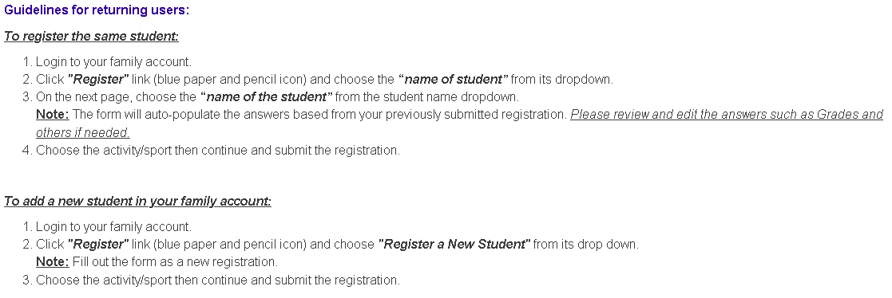
ATHLETIC REGISTRATION

Slide 6
ATHLETIC REGISTRATION
UPON COMPLETION OF THE ONLINE PACKET, STUDENT ATHLETES NEED TO PRINT OUT AND TURN INTO SCHOOL NURSES OFFICE EITHER A NEW PHYSICAL SIGNED OFF BY THE DOCTOR http://ehthsathletics.weebly.com/uploads/5/8/1/1/58116083/2019-2010_physical_form.pdf
OR COMPLETE A RE-CERTIFICATION PACKET AND TURN IN TO THE SCHOOL NURSES OFFICE
http://ehthsathletics.weebly.com/uploads/5/8/1/1/58116083/re-certification_2019-2020.pdf

Slide 7
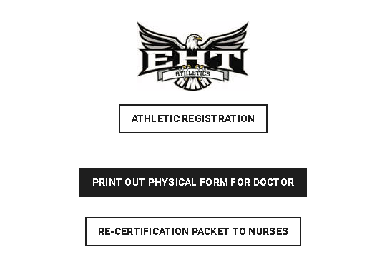
ATHLETIC REGISTRATION
ALL OF THESE TABS ARE LOCATED ON THE ATHLETICS WEBPAGE AT THE HIGH SCHOOL

Slide 8
KEY POINTS FOR ATHLETIC PHYSICALS & RECERTIFICATIONS
Activity Registration must be completed online (Permission to Participate, Cardiac, Steroid, Concussion, Opioid, Emergency Contact forms)
Activity Registration must be completed at the beginning of the school sports year (Summer) REGARDLESS of actual physical date
Papers to be turned into Nurse’s office
Physical Form For Doctor – Once per year
History Form
Athlete With Special Needs (if applicable)
Physical Examination Form
Clearance Form
Re-Certification Packet to Nurses – for every sport
Health History Update Questionnaire
Permission for Participation In Athletics
Sports Emergency Form

